Slide 1

Predicting Market Values of the Football Players
Team 3

Slide 2

Introduction
Nowadays, FIFA is the most important association that governs football federations all over the planet and attracts a lot of fans. Because of its popularity, many football associations obtain huge incomes. Thus, soccer clubs are companies. These companies always make important decisions in relation to who football player they want to employ. It has been a fact that transfers of players make a significant impact on football clubs, cities, countries, and governments. Also, the market value of players provides a budget for these transfers. Therefore, the market value of a player is important to sales and profit for the clubs, which pay attention to analysis and predict player value. So, our question is “ what kind of factors will influence the market value of a player?”

Slide 3

Project Objective & Target Audience
Develop an optimal model using Multiple Linear Regression to predict the market values of the players.
Target Audience:
Sports statistics fans
Enthusiasts of football

Slide 4
Data Source
Name: “Football Data from Transfermarkt”
Description
Clean, structured and automatically updated football data from Transfermarkt, including:
40,000+ games from many seasons on all major competitions
300+ clubs from those competitions
20,000+ players from those clubs
900,000+ player appearance records from all games
Source: Kaggle
Data
Notes:
Source:https://www.kaggle.com/davidcariboo/player-scores?select=players.csv

Slide 5
Data Source
Name: “Top 250 Football transfers from 2000 to 2018”
Description
The dataset of top 250 most expensive football transfers from season 2000-2001 until 2018-2019.There are 4700 total rows and 10 columns in this dataset. The columns contain the following information: the name of a football player, selling team and league, the league and team where a player is sold, an estimated market value of a player, an actual value of a transfer, the position of a of a player and season when a transfer took place.
Source: Kaggle
Data
Notes:
Source:https://www.kaggle.com/vardan95ghazaryan/top-250-football-transfers-from-2000-to-2018

Slide 6
Data
Data Source
Name: “SoFIFA.com”
Description
It is a web page that has details each player's biological data, wage, club, positions, and skills in player cards. This player information is updated through time. From 2007 to 2012, the player cards were updated biannually.
Source: Web Page
Notes:
Source:https://www.kaggle.com/davidcariboo/player-scores?select=players.csv
Source:https://www.kaggle.com/vardan95ghazaryan/top-250-football-transfers-from-2000-to-2018

Slide 7
Questions We hope to answer with the data
what kind of factors will influence the market value of a player?
How much does the market value of the players increase on average?
Player performance and club rank can make a significant impact on player value.

Slide 8

Potential Features and Target Variable
Club Market Value
Player Position
Red Cards
Yellow Cards
Market value
Assists
Transfer
Fee
Age
Games
Hours Played
Goals

Slide 9

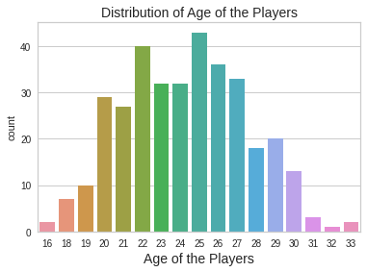
Distribution of age for each Players

Slide 10




FIFA Performance Dashboard
Notes:
https://izhakfc.github.io/test/

Slide 11
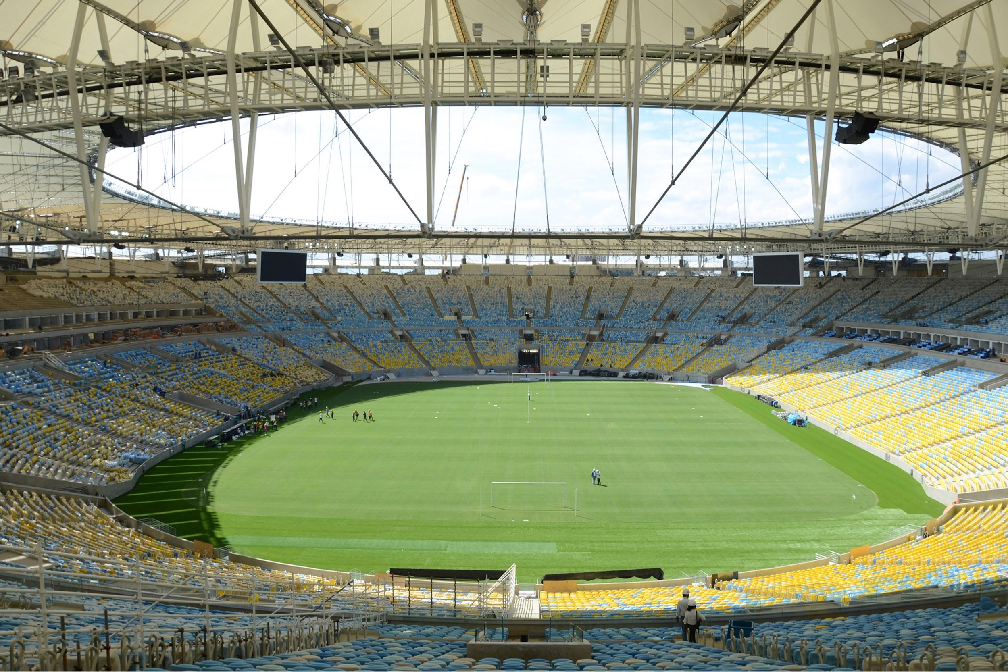



Football Dashboard
Notes:
https://sites.google.com/view/team3bootcamp/dashboard

Slide 12
Multiple Linear Regression
Notes:
https://github.com/Edgarhv/Predicting-Football-soccer-using-a-Machine-Learning-Model/tree/main

Slide 13
Method
We used a multiple linear regression analysis because the multiple regression model not only helps us to make predictions about the data but also can help us to identify the variables that have a significant effect on the dependent variable (market_value). So it was suitable as well as reasonable for us to use here.

Slide 14
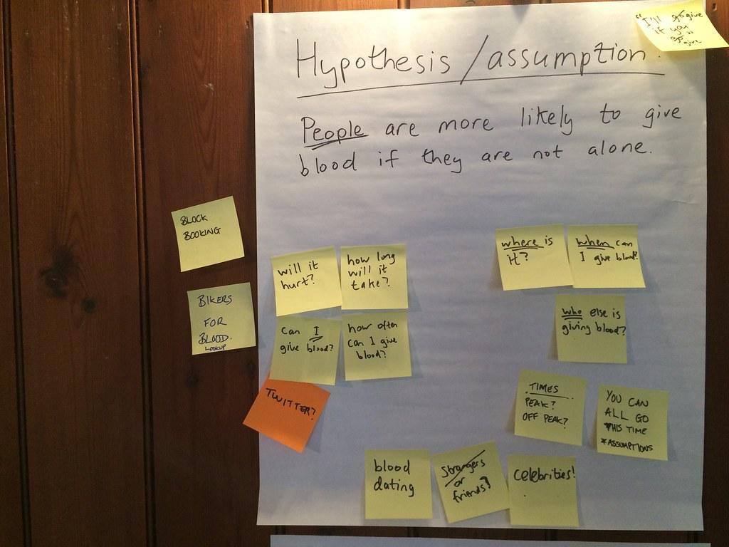
Hypothesis
Player personal information, player performance, and club market value can make a significant impact on player value.

Slide 15

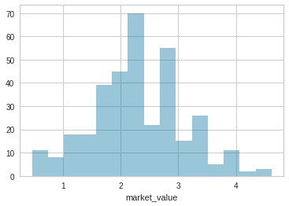
Correlation Plot

Slide 16

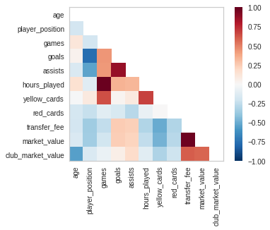
Correlation Plot

Slide 17
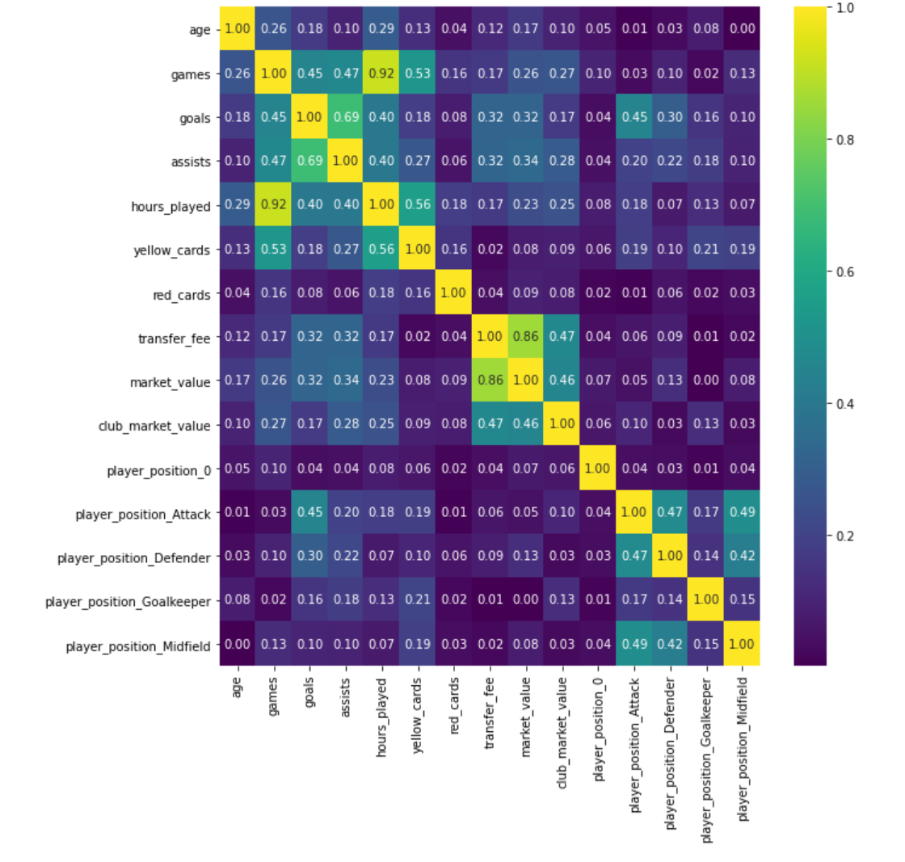
Future Correlation Heatmap

Slide 18

We selected 10 independent variables and one dependent variable from players, matches, and team data of European football from 2017 to 2018. The independent variables are divided into three categories: physical data of the players, performance data of the players, and the market of the club. The dependent variable is the players’ market value. After importing the raw data into Python for data cleaning we get a dataset of 348 rows and 11 columns.
*Where e is the error term, DV is the dependent variable.*
Data Analysis

Slide 19
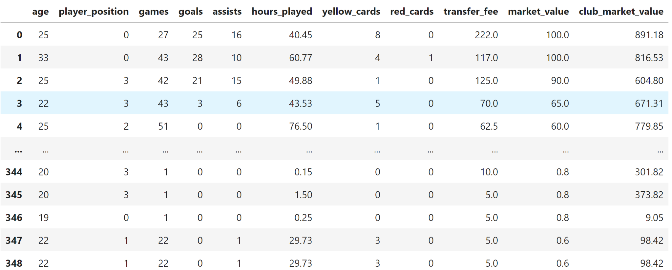
Data Analysis

Slide 20
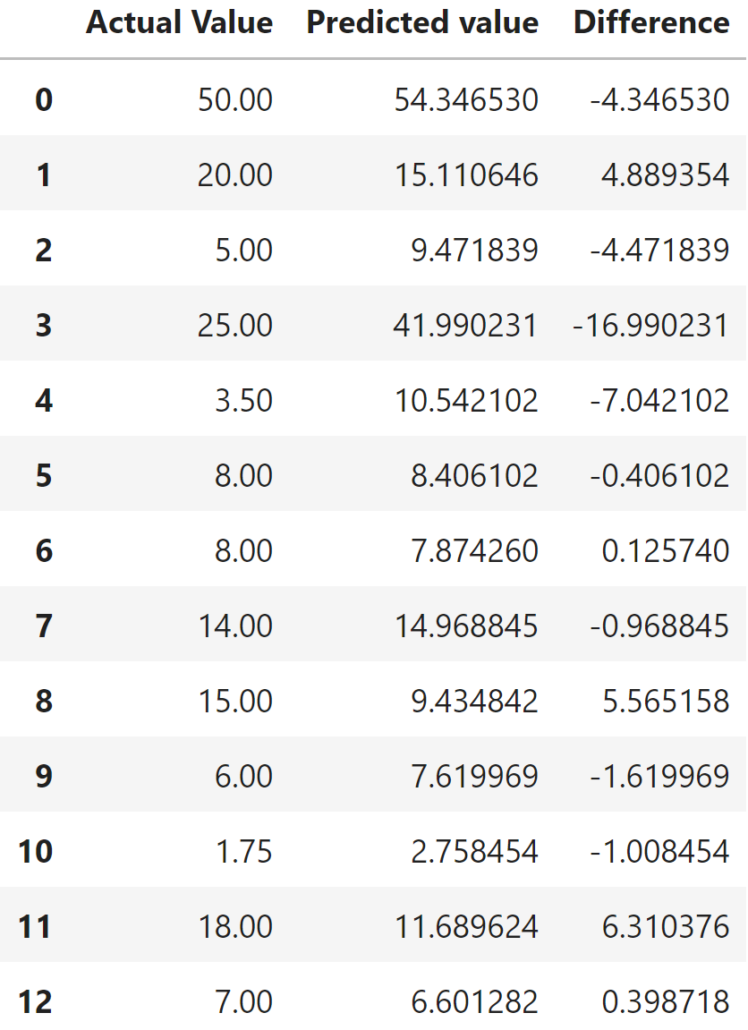
Actual vs Predicted Value
Comparison: Predicted
Value

Slide 21
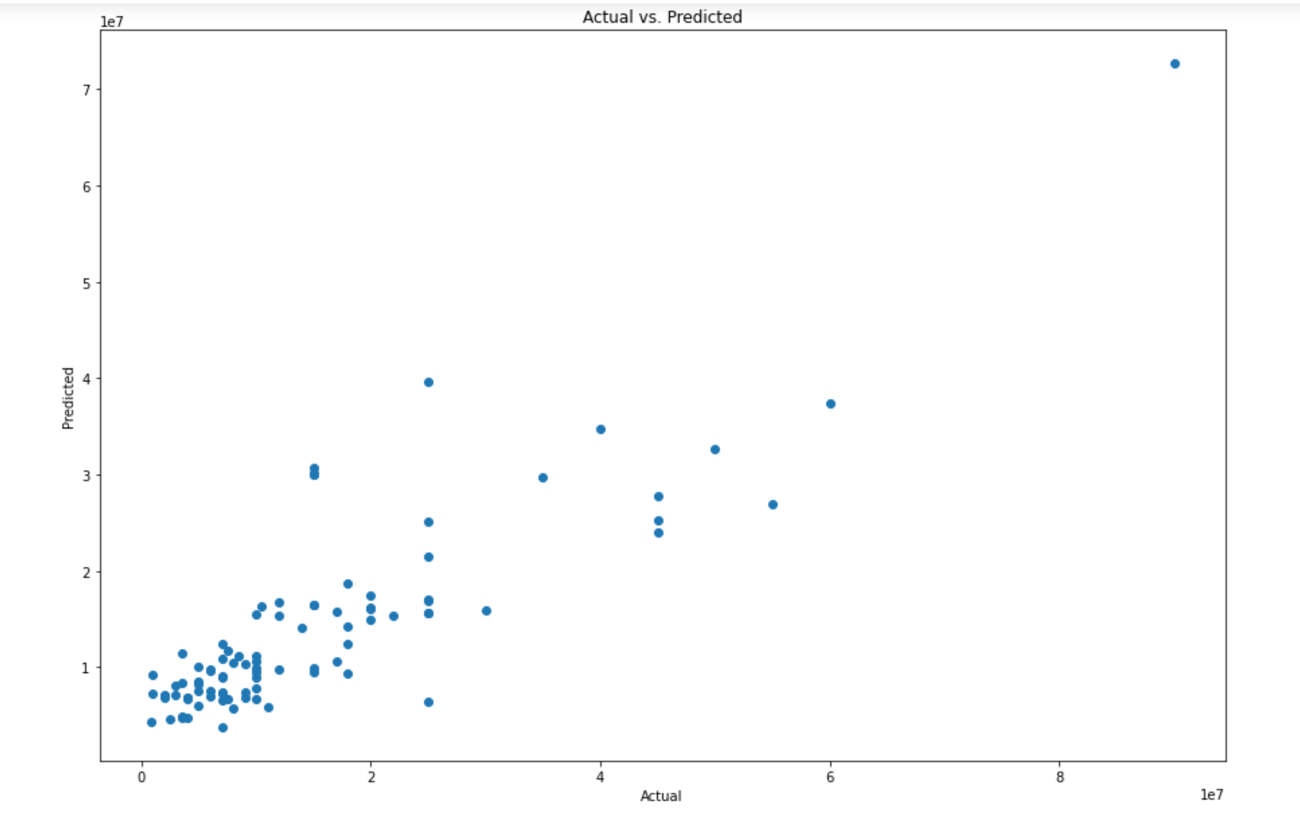

Slide 22
PyCaret
PyCaret is an open-source, low-code machine learning library in Python that automates machine learning workflows. It is an end-to-end machine learning and model management tool that speeds up the experiment cycle exponentially and makes you more productive.

Slide 23
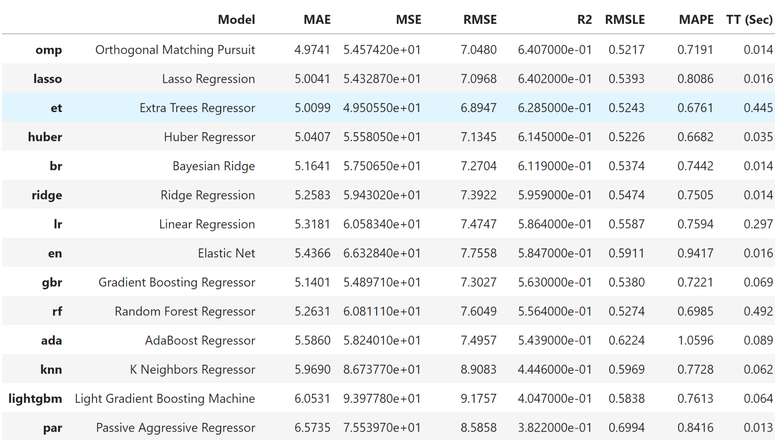
Compare Models

Slide 24
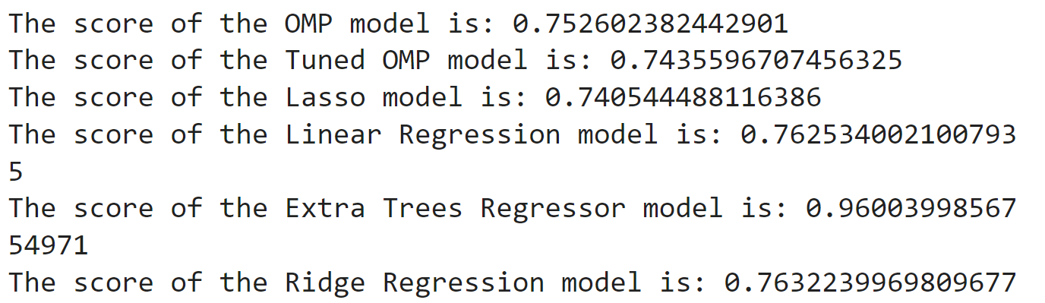
Perform test with every model

Slide 25
Extra Tree Regression Model
Extra Trees is an ensemble machine learning algorithm that combines the predictions from many decision trees.
It is related to the widely used random forest algorithm. It can often achieve a good or better performance than the random forest algorithm, although it uses a simpler algorithm to construct the decision trees used as members of the ensemble.
Regression: Predictions made by averaging predictions from decision trees.

Slide 26
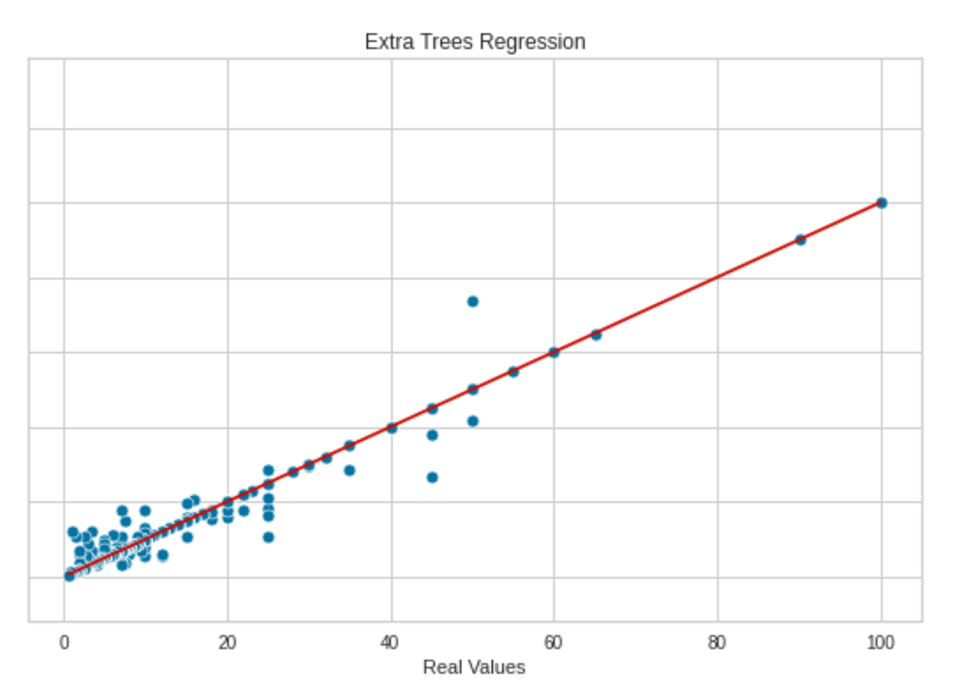
Extra Tree Regression Model

Slide 27
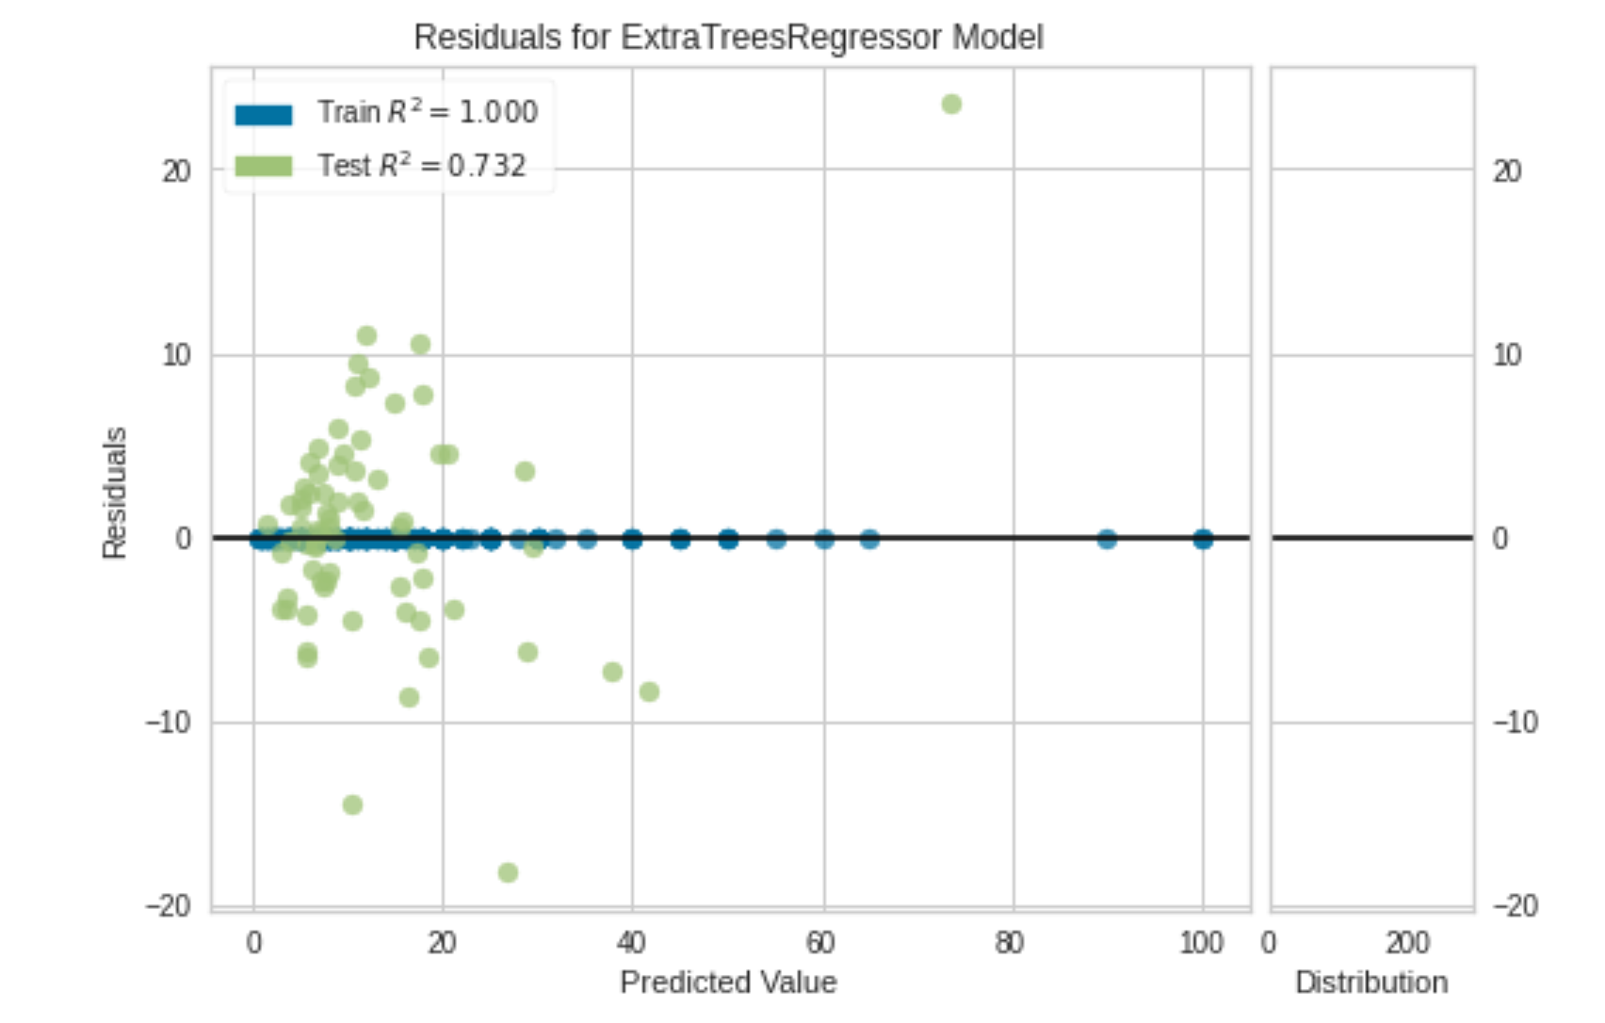
Extra Tree Regression Model

Slide 28
Extra Tree Regression Model

Slide 29
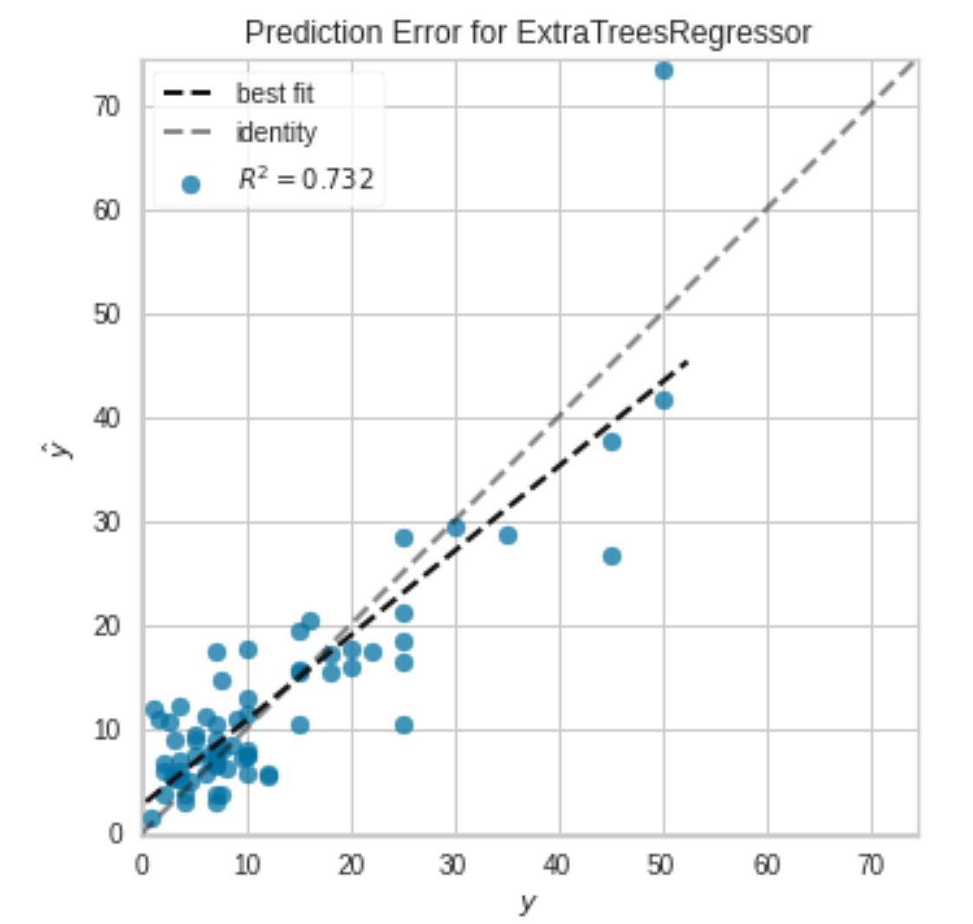
Extra Tree Regression Model

Slide 30
Extra Tree Regression Model

Slide 31
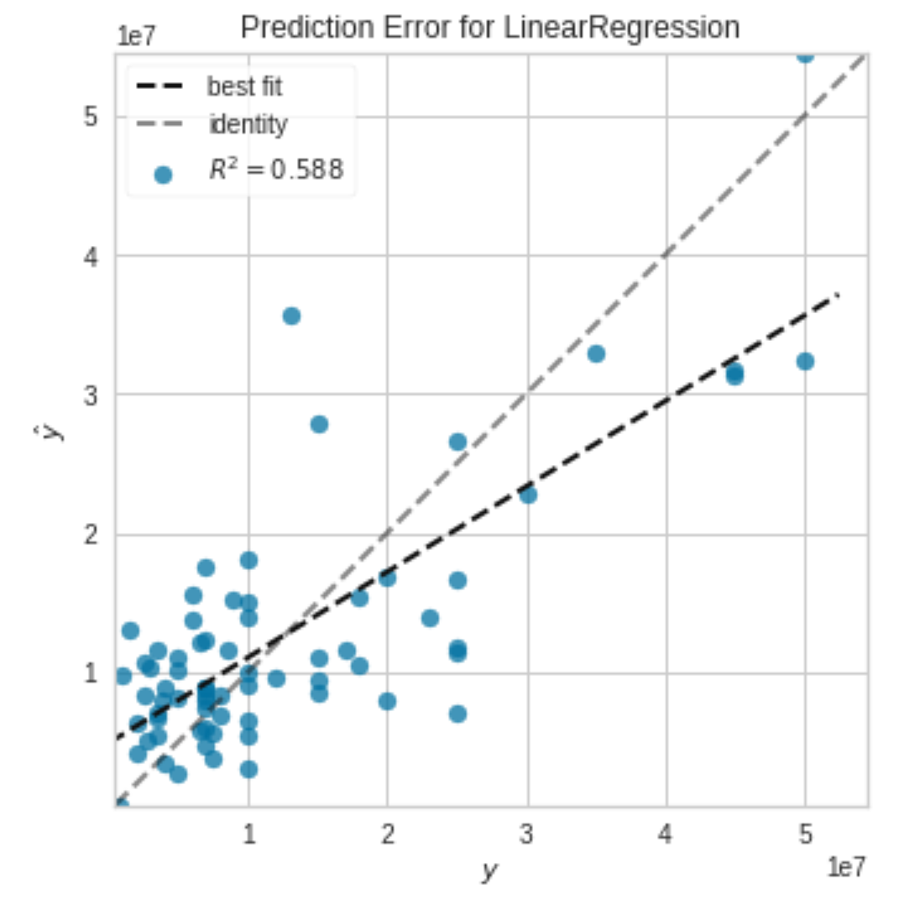
Linear
Regression Model

Slide 32
Conclusion

Slide 33




Future Iterations
Incorporate new data
Divide the data by clusters( player position)
Run the model for a more current season and compare.

